Slide 1
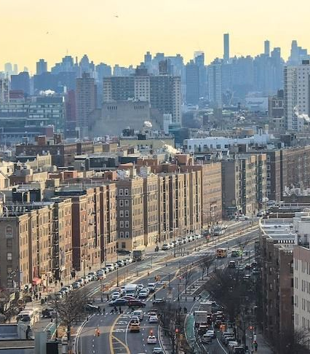
Bronx Real Estate
01.18.2020

Slide 2

Why Bronx?

Slide 3

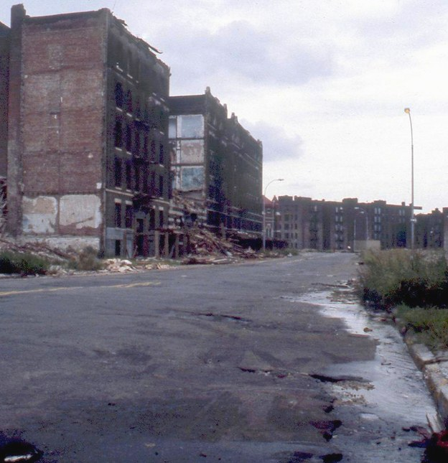



How people think it is

Slide 4





How it actually is

Slide 5

Analysis done
Collected and reviewed multiple Bronx data sets for 15 years
Created multiple linear regression machine learning model to process data
Utilized the above model for predictive analysis of real estate prices
Utilized D3 to plot the analyzed neighborhood data
Created graphs to show price values for years under analysis

Slide 6

What we learned
The Bronx is investor friendly, since there is not a lot of capital needed
Investors still can get tangibles returns
Only one neighborhood in the Bronx, where the average price for one family home is $1mil
Square footage has the most impact on the price of property

Slide 7

Difficulties Encountered
Data processing
Model limitations
Data limitations
Analysis complexity
Inability to access specific data

Slide 8
The Verdict
INVEST!
Make money!
But… safety first:
https://www.rentapplication.com/this-map-shows-you-every-sex-offender-in-nyc/

